Slide 1
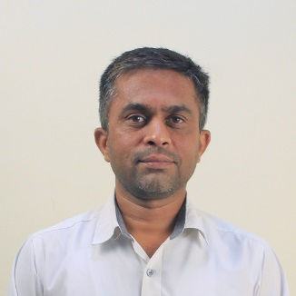
Unit-1 Introduction to Internet of Things
IOT and Applications
GTU # 3160716
Prof. Kalpesh H Surati
Computer Engineering Department
Kalpesh.surati@darshan.ac.in
+91 99250 10033

Slide 2
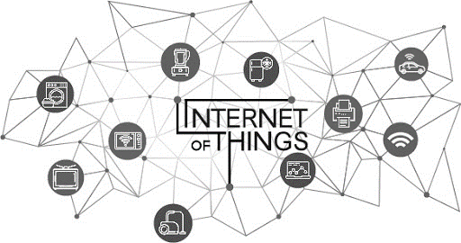
Introduction to Internet of Things (IoT)
First of all we should discuss about the name “IoT – Internet of Things” in detail.
So we have to discuss about the first word “Internet” and then everything about the “Things”.

Slide 3
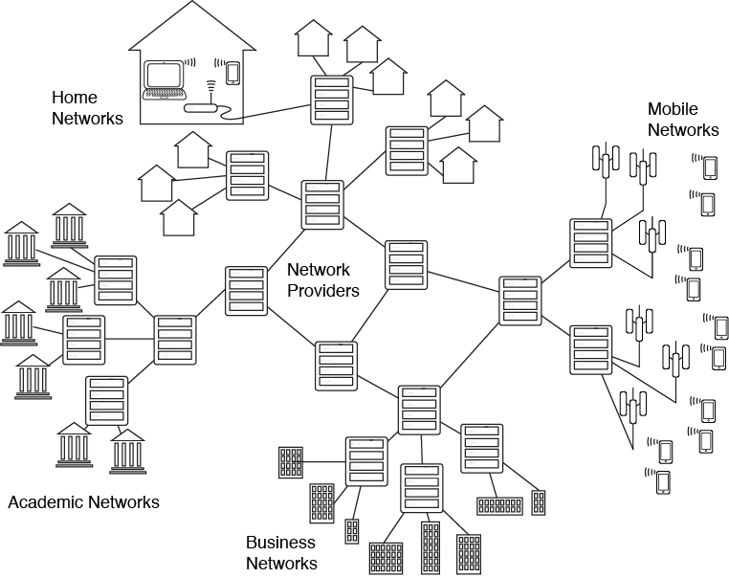
Introduction to Internet of Things (IoT)
What is Internet?
In simple word, it’s a Network of Networks or Interconnected LANs.
So here we have to discuss about the Network, and we already learned everything about network in the last semester, Right?
What is Network?, Requirement for networking

Slide 4
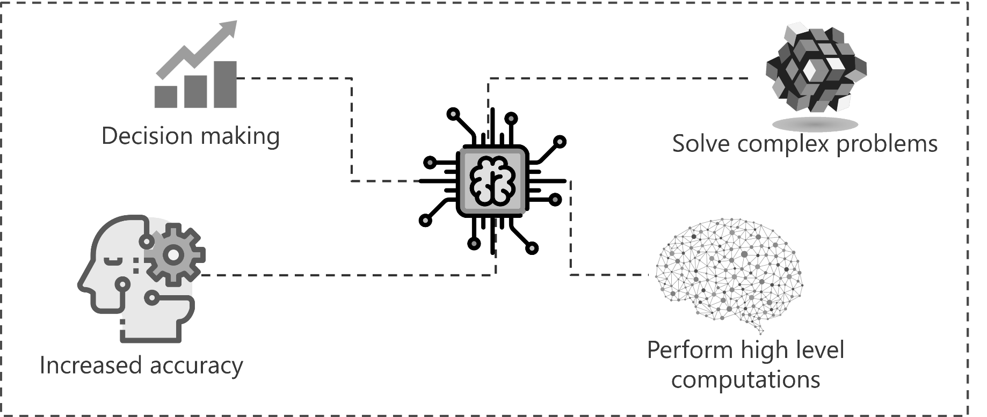
Introduction to Internet of Things (IoT)
Nowadays The term Internet of Things (IoT) is an emerged the popular terms.
There are multiple ways to define IoT, but the basic of all the definitions remains the same.
IoT is network of interconnected computing devices which are embedded in everyday objects, enabling them to send and receive data.
The IoT is not just limited to the connected or networked devices, but in a broad way IoT devices exchange meaningful information from one device to another to get desire result.

Slide 5
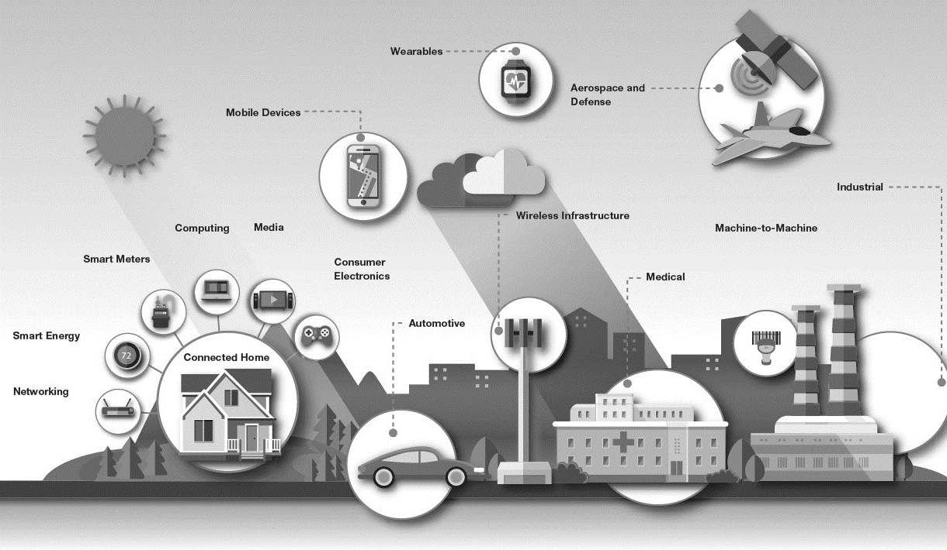
Introduction to Internet of Things (IoT)
IoT is not a single technology, it’s a combination of technologies and domain knowledge.
As a result, engineers from different domains have to work together for building a complete IoT product.
Life would be governed entirely by Internet and IoT in the near future.

Slide 6
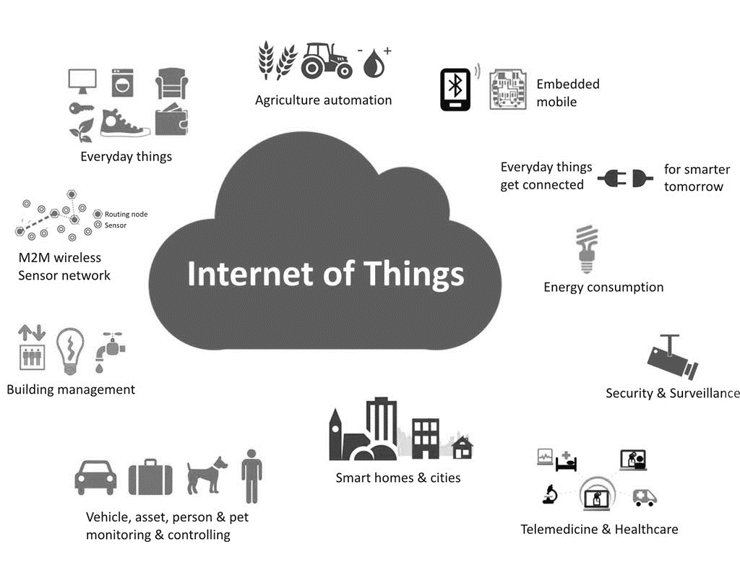
Application areas of IoT
The scope and application areas of IoT is very huge.
IoT can be used to build applications for…
Agriculture
Assets Tracking
Energy Sector
Defense
Embedded Applications
Education
Waste Management
Healthcare Products
Telemedicine
Safety And Security Sector
Smart City Applications etc.

Slide 7
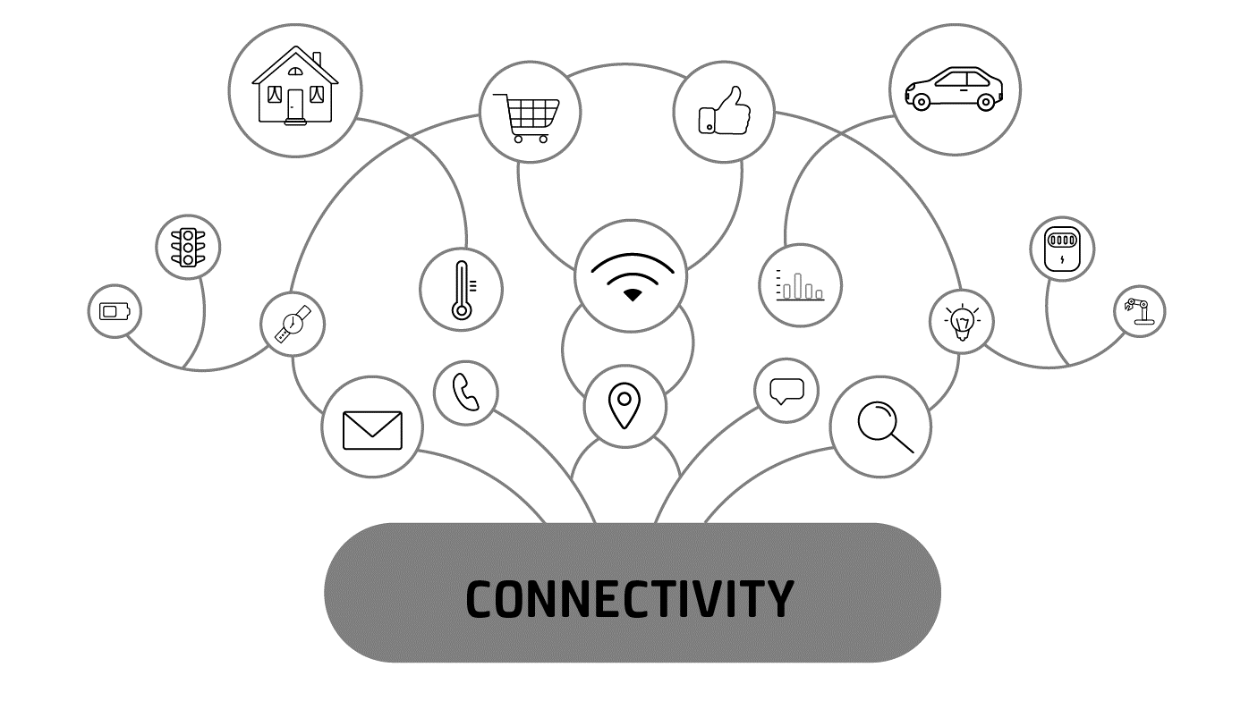
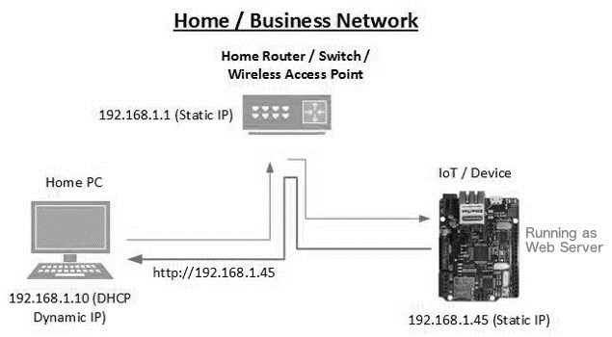
Characteristics of IoT
Connectivity:
Connectivity is an important and first requirement of IoT infrastructure.
Every Things in IoT should be connected to the IoT infrastructure.
Connectivity should be guaranteed at anywhere and anytime.
Identity:
Each IoT device has a unique identity (e.g., an IP address).
This identity is helpful in communication, tracking and to know status of the things.

Slide 8
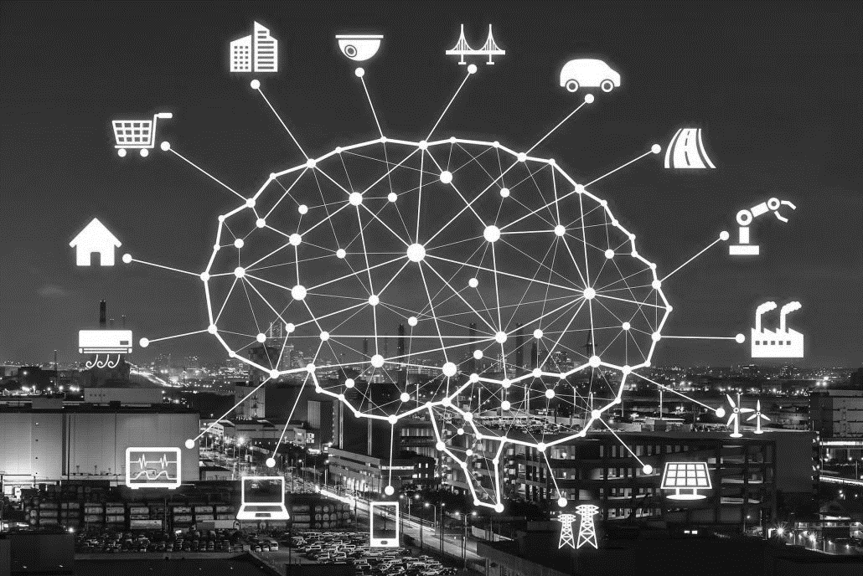
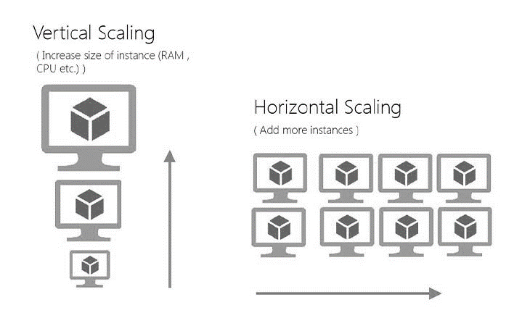
Characteristics of IoT
Intelligence:
Just data collection is not enough in IoT, extraction of knowledge from the generated data is very important.
For example, sensors generate data, but that data will only be useful if it is interpreted properly.
So intelligence is one of the key characteristics in IoT.
Scalability:
The number of elements (devices) connected to IoT zone is increasing day by day.
Therefore, an IoT setup should be capable of handling the expansion.
It can be either expand capability in terms of processing power, Storage, etc as vertical scaling or horizontal scaling by multiplying with easy cloning

Slide 9
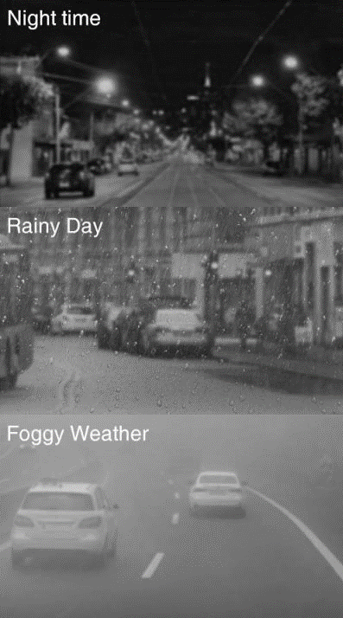
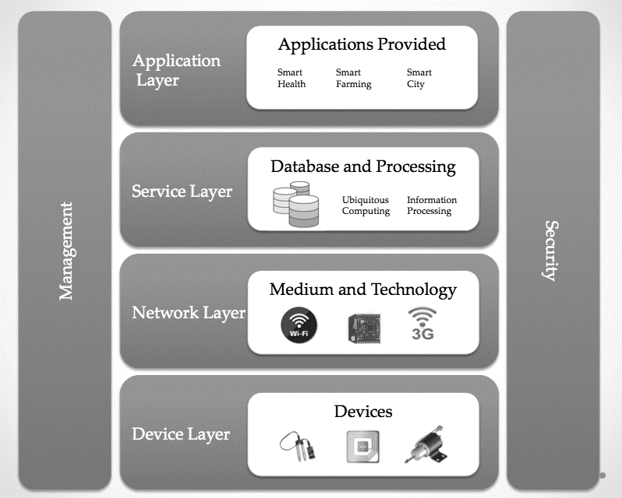
Characteristics of IoT
Dynamic and self-adapting (complexity):
IoT devices should dynamically adapt themselves to the changing surroundings.
For example surveillance camera. It should be flexible to work in different weather conditions and different light situations (morning, afternoon, or night).
Architecture:
IoT architecture is yet not uniformed and standardized.
It should be hybrid, supporting different manufacturer’s products to function in the IoT network.

Slide 10
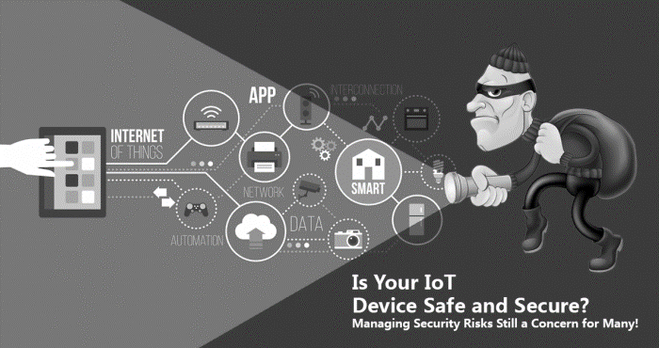
Characteristics of IoT
Safety:
Sensitive personal details of a user might be compromised when the devices are connected to the Internet.
So data security is a major challenge.
This could cause a loss to the user.
Equipment in the huge IoT network may also be at risk.
Therefore, equipment safety is also critical.

Slide 11
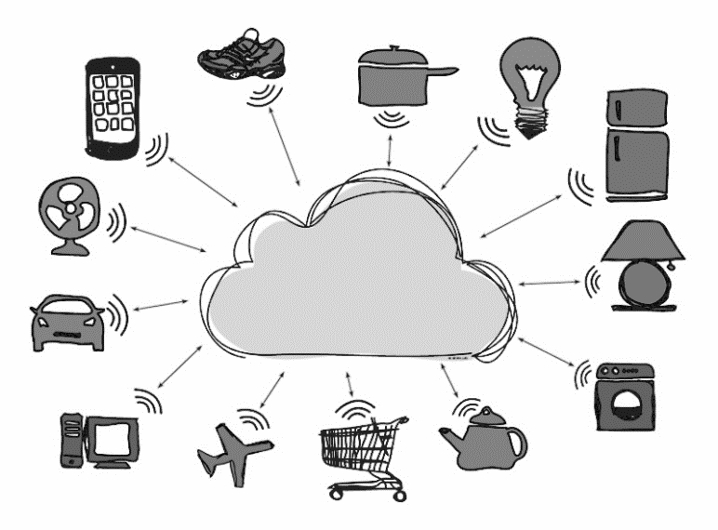
Things in IoT
In the IoT, things refer to a variety of devices. It can be anything even humans in it become a thing.
For something to qualify as a “thing”, it requires identity of its existence.
The “thing” in a network can be monitored/measure. For example, a temperature sensor could be a thing.
Things are capable of exchanging data with other connected devices in the system.
The data could be stored in a centralized server (or cloud), processed there and a control action could be initiated.
The devices having all the above characteristics are known as things.

Slide 12
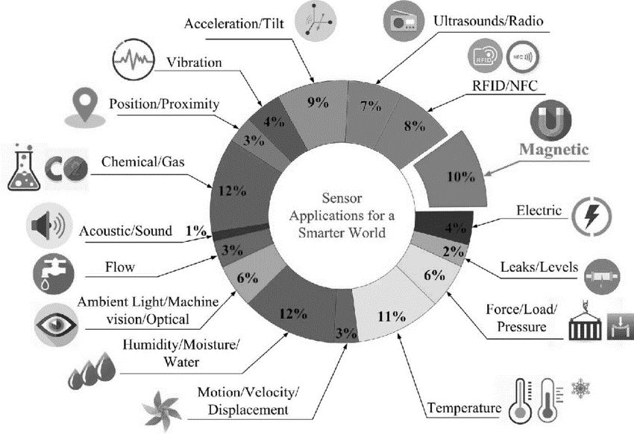
Things in IoT
Some of the famous “things” are temperature sensors, pressure sensors, humidity sensors, etc.
The data from these sensors are collected and sent it to the cloud or stored it in local server for data analysis.
Based on the data analysis, the control action would be taken.
For example, switching off the water heater remotely when the water is heated as per requirement.

Slide 13
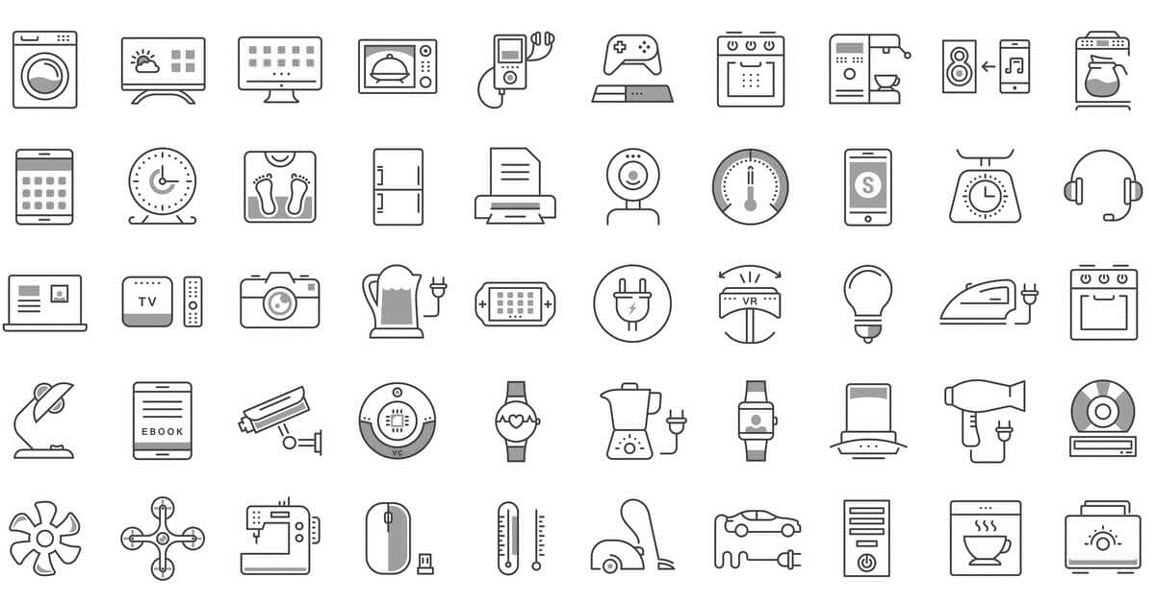
Things in IoT
Not just sensors, the following can also be called as things:
Industrial motors
Wearables (e.g., watch)
Vehicles
Shoes
Heart monitoring implants (e.g., pacemaker, ECG real-time tracking)
Biochip transponders (for animals in farms)
Automobiles with built-in sensors (automobile feature real-time monitoring)
Food/perishables quality measuring

Slide 14
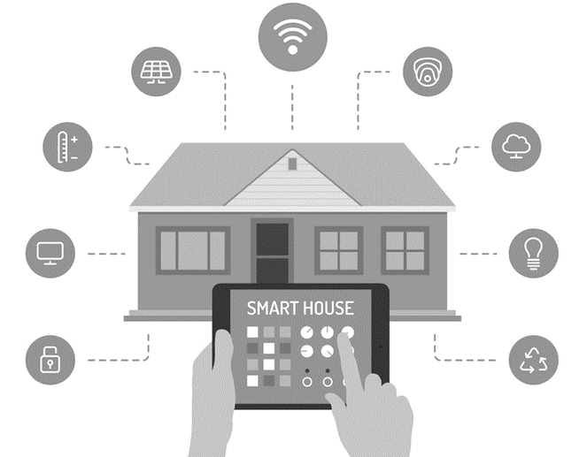
Things in IoT
In IoT-based home automation, the “things” could be the following
Lighting control and automation devices
Ventilation devices
Air conditioning [heating, ventilation and air conditioning (HVAC)] systems
Appliances such as washer/dryer
Air purifiers
Ovens or refrigerators/freezers that use Wi-Fi for remote monitoring
Security cameras
Smart phones

Slide 15
IoT Stack
Like other digital technology IoT has stack layers.
Following are the identified seven layers in IoT stack.
Layer 1 (Physical or Sensor Layer)
Layer 2 (Processing and Control Action layer)
Layer 3 (Hardware Interface Layer)
Layer 4 (RF Layer)
Layer 5 (Session/Message Layer)
Layer 6 (User Experience Layer)
Layer 7 (Application Layer)
Layer 7
Application Layer
Layer 6
User Experience Layer
Layer 5
Session/Message Layer
Layer 4
IoT Protocol Stack Layers
RF Layer
Layer 3
Hardware Interface Layer
Layer 2
Processing and
Control Action Layer
Layer 1
Physical or Sensor Layer

Slide 16
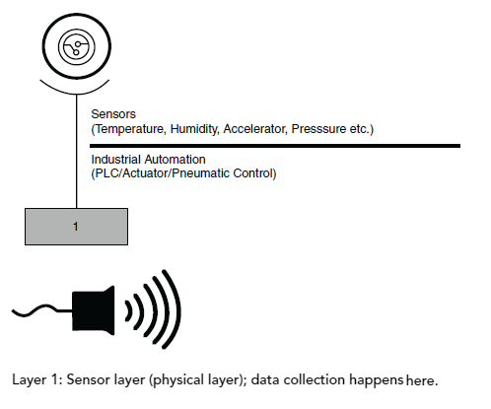
IoT Stack - Layer 1 (Physical or Sensor Layer)
This layer is concerned about the physical components, which mainly includes sensors.
In this layer, the sensors are the core component.
Temperature sensor, pressure sensor, humidity sensor, etc. can all be referred as physical layer components.
In industrial automation, PLC, actuator, etc. are considered as physical layer components.
This layer is responsible for data collection and action execution.
Selection of sensors is important and choosing an appropriate sensor is the challenge in this layer.
Action execution, sensing and data collection happens here.

Slide 17
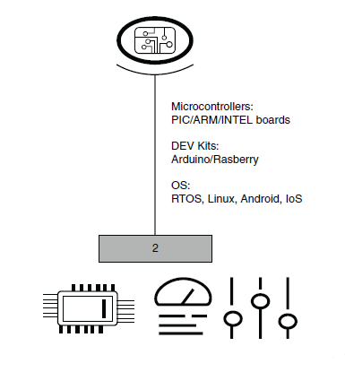
IoT Stack - Layer 2 (Processing and Control Action Layer)
This important layer contains core components of IoT system.
The microcontrollers or processors are found in this layer.
The data is received by the microcontrollers from the sensors.
A variety of development kits are available in the market; like Arduino, Raspberry Pi, Node MCU, PIC, ARM development boards, etc.
Microcontroller/Processor and operating system play vital role at this layer
Data collected from the sensors is processed in this layer.

Slide 18
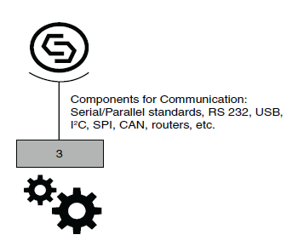
IoT Stack - Layer 3 (Hardware Interface Layer)
The 3rd layer in the stack is the Hardware Interface Layer.
Hardware components and communication standards such as RS232, CAN, SPI, SCI, I 2C, etc. occupy this layer.
All these components ensure flawless communication
Handshake happens here.

Slide 19
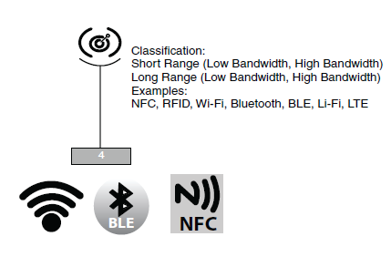
IoT Stack - Layer 4 (RF Layer)
Whenever one talks about IoT, RF is discussed and comes in picture.
It plays a major role in the communication channel – whether it is short range or long range.
Protocols used for communication and transport of data based on RF are listed in this layer.
Some famous and common protocols are Wi-Fi, NFC, RFID, Bluetooth, Zigbee, etc.
RF layer does communication of data using radio frequency based Electromagnetic (EM) waves
This layer can also include Li-Fi; which are effective alternates for RF protocols.

Slide 20
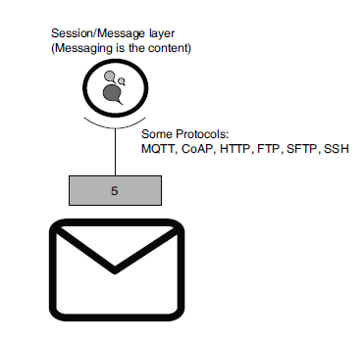
IoT Stack - Layer 5 (Session/Message Layer)
Like computer network session management is also important in IoT.
There are many protocols which manage how messages or data are broadcasted to the cloud.
Layer 5 (session layer) deals with the various messaging protocols as MQTT, CoAP, etc. and also other protocols such as SSH and FTP.

Slide 21
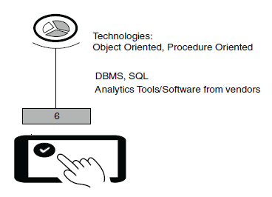
IoT Stack - Layer 6 (User Experience Layer)
This layer deals with providing best experience to the end users of IoT products.
The 6th layer takes care of rich UI designs with lots of features, which provide a pleasing experience while using the service/system or product.
Object-oriented programming languages, scripting languages, analytics tools, etc. all should be included in this layer.
This is also known as User Experience and Visualization Layer.

Slide 22
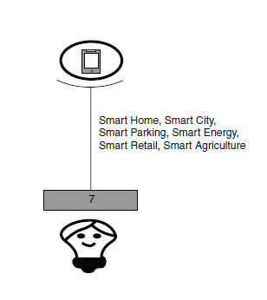
IoT Stack - Layer 7 (Application Layer)
Everything comes to perfection at this layer.
This layer utilizes the rest six layers in order to develop desired application.
It can range from a simple automation application to smart city application.
After learning about the layers, it is now easier to relate them with an application, for example, vegetable quality monitoring during transport from source to the destination using IoT.

Slide 23
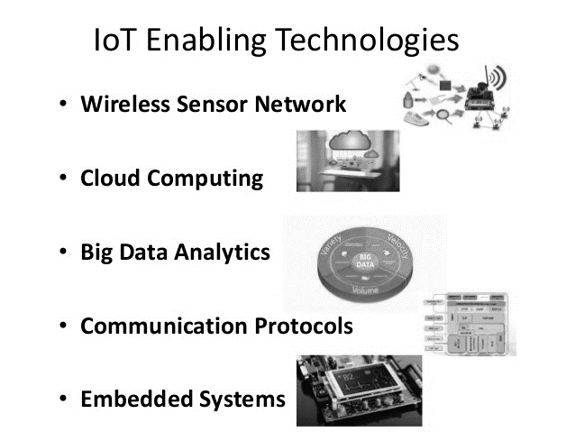
Enabling Technologies
IoT is a collection or group of many technologies and devices.
The simplest of sensors, embedded systems, data analytics, communication protocols, security aspects and cloud computing with storage have all become enabling technologies.
Enabling technologies/devices fall under one of the following categories:
Technologies that help in acquiring/sensing data.
Technologies that help in analyzing/processing data.
Technologies that help in taking control action.
Technologies that help in enhancing security/privacy.
Let’s discuss some of the enabling technologies.

Slide 24
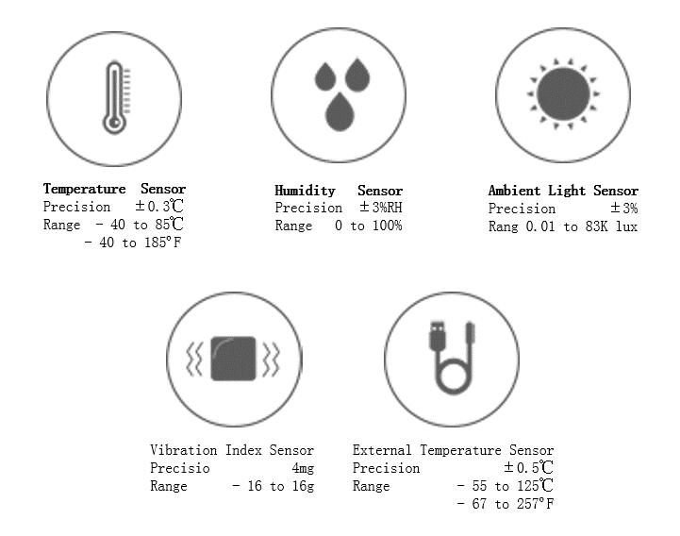
Enabling Technologies - Sensors
Sensors are at the heart of any IoT application.
As the name suggests, they sense the environment and retrieve data.
Sensors are the starting point of any IoT application.
It fetches data for us to operate on.
Sensors could be analog or digital.
Temperature sensor in a thermometer is an example of it. It is used to build temperature monitoring application.

Slide 25
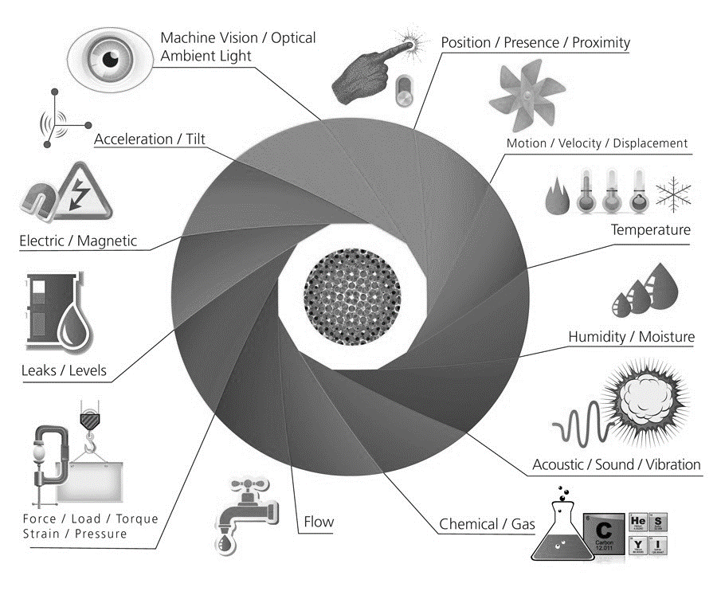
Enabling Technologies - Sensors
Some examples of sensors that could be regarded as enabling technologies are as follows.
Weather tracking system uses temperature/humidity/moisture sensors.
Vehicle health monitoring sensors keep track of speed, tyre pressure, etc.
On Board Diagnostics (OBDs) used for collecting all critical information from an automobile to detect error.
Vibration sensors are used to track the quality of buildings/structures.
Water quality is monitored through sensors that measure PH, chloride level, etc.
PIR sensor is used in pedestrian signal operation with human presence detection.

Slide 26
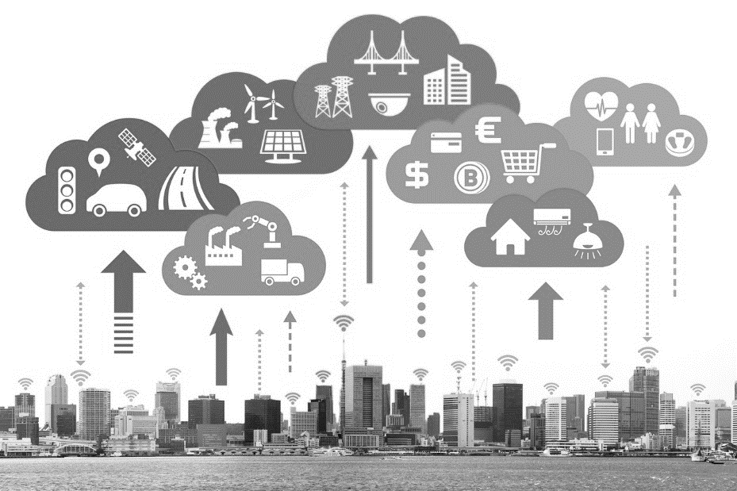
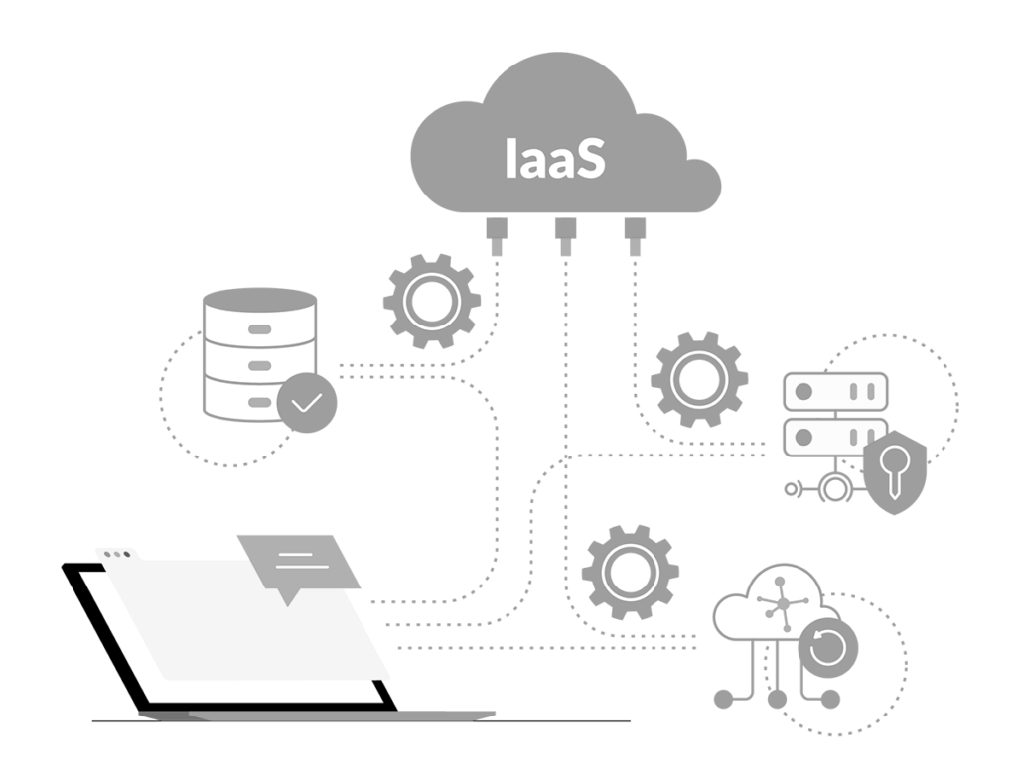
Enabling Technologies - Cloud Computing
The next technology that is highly significant in IoT is cloud computing.
Cloud has grown much more popular because it serves as an affordable, effective and efficient medium for data storage.
Data storage plays a major role in IoT.
Cloud services are categorized as follows:
IaaS (Infrastructure-as-a-Service):
In this cloud service, one can choose virtual machines over physical machines.
It is a form of cloud computing that provides virtualized computing resources over the Internet.
The users manage the machines, select the OS and underlying applications, and pay per their use.

Slide 27
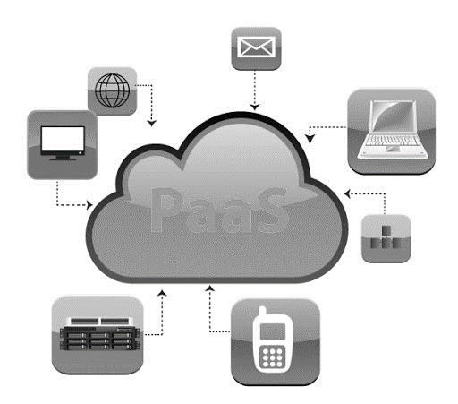
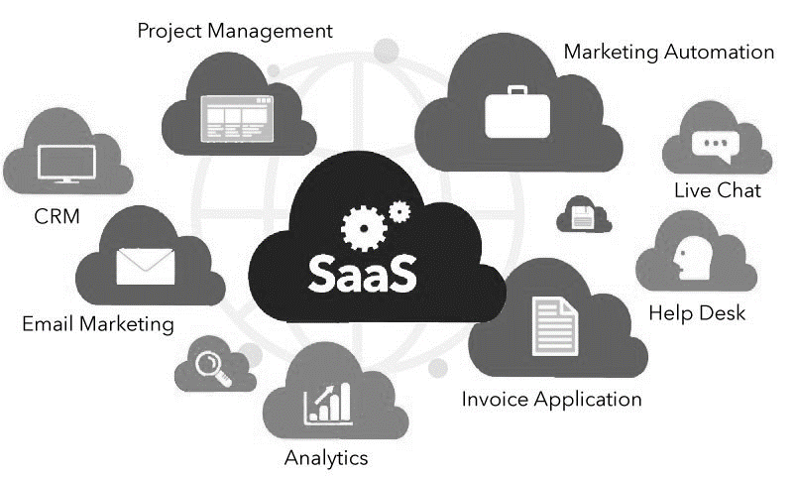
Enabling Technologies - Cloud Computing
PaaS (Platform-as-a-Service):
This is a cloud computing model in which the cloud service provider delivers hardware and software tools needed for application development to users over the Internet.
A PaaS provider hosts the hardware and software on its own infrastructure. Users have to build, manage and maintain the applications as per their requirement.
SaaS (Software-as-a-Service):
In this model, a complete software application is provided to the user.
It can also be called application as a service. This service can be availed by paying a monthly, yearly, etc., subscription.
Some well-known service providers in the market are Amazon web services, Azure and Adafruit.

Slide 28
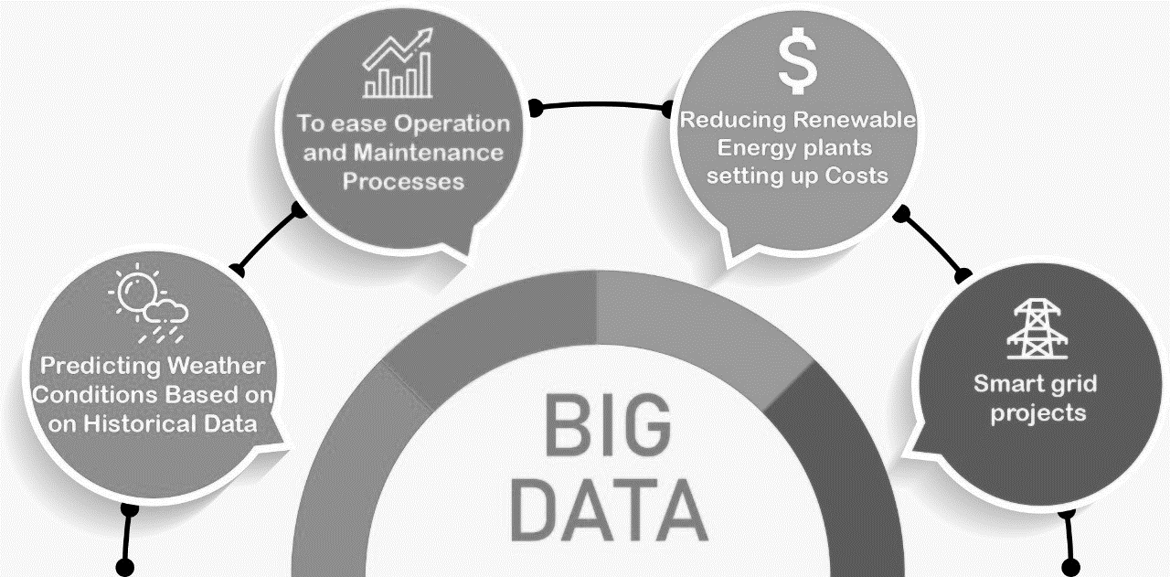
Enabling Technologies - Big Data Analytics
Data is everywhere, and from every function or operation we get more data.
IoT is all about collecting data from various sensory nodes.
Handling the huge data is fundamental to make the application a success.
The biggest challenge with big data is 4Vs. Volume, Variety, Speed (Velocity) at which it comes and its Veracity.

Slide 29
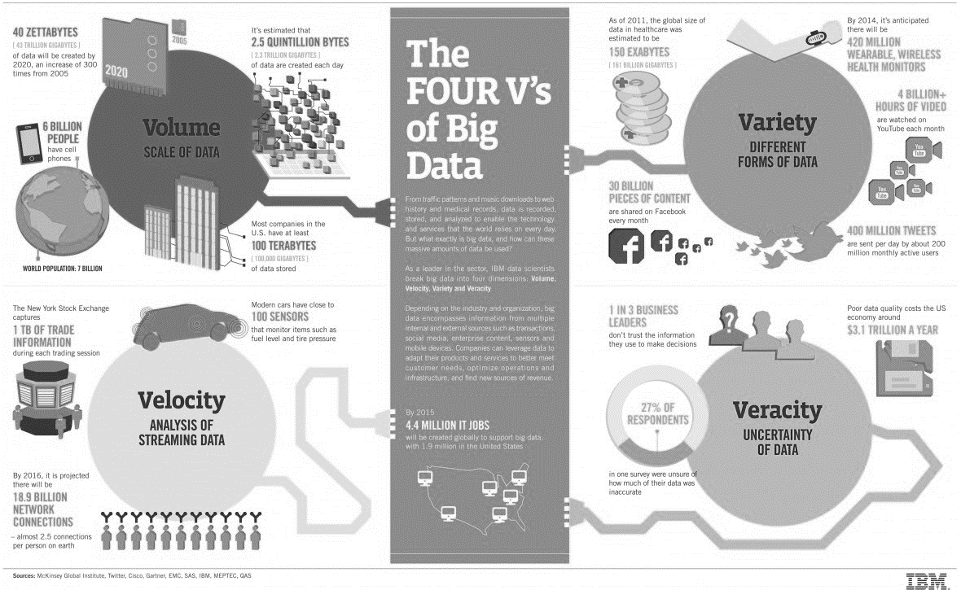
Enabling Technologies - Big Data Analytics
Scale (Volume):
Huge volume of data is generated every minute.
Storage has become inexpensive and hence, cost-related challenges have reduced.
Cloud storage and hardware storage both have become affordable because of the tremendous growth in the semiconductor industry.
Complexity (Variety):
Data no longer comes from one single source.
It also comes in different formats (e.g., audio, video, text and image) and has to be interpreted systematically.
Varieties of data becomes a huge challenge.

Slide 30
Enabling Technologies - Big Data Analytics
Speed (Velocity):
The rate at which data is generated very fast.
Also, data dynamics changes very frequently.
Nowadays, data comes from anywhere – from fit bit watches to refrigerators.
All the data pours in at a very high speed, which makes it very challenging.
Data in doubt (Veracity):
How accurate is all this data anyway?
Because we are now rely on it
The data’s nature alters dynamically and uncertainty is often seen.
So, it would be challenging to process this unstable data.

Slide 31
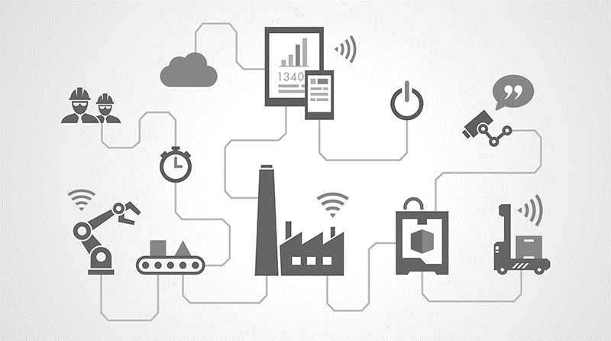
Enabling Technologies - Big Data Analytics
So the question is: “Who is generating all this data?” A partial list to answer this is as follows:
Sensors from security systems.
Sensors from weather monitoring systems.
Sensors from car/navigation systems.
Sensors from water quality monitoring systems.
Data from wearables (e.g., bands).
Data from industrial equipment (e.g., motor health).
Sensors from bridges/roads about traffic density and other factors.
Social media (e.g., tweets, photo uploads, etc.).
In IoT data is everything. so, data analytics is one of the enabling technologies for building a complete and IoT application.

Slide 32
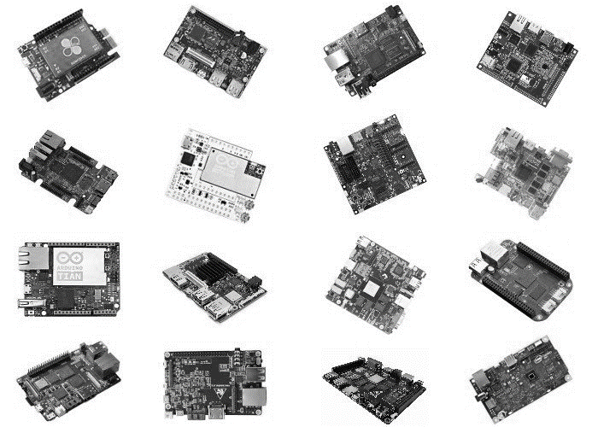
Enabling Technologies - Embedded Computing Boards
An embedded computing board a very important component to bring IoT design to reality.
For making the prototype the computing boards play vital role.
The computing boards available in the market are driven by microcontrollers or processors.
Some of the boards are as follows:
Raspberry Pi.
Arduino (many variants).
NodeMCU.
Intel Edison.
All these boards are small, yet smart.
Also, the cost involved is very minimal and one can get these boards at cheap rate.

Slide 33
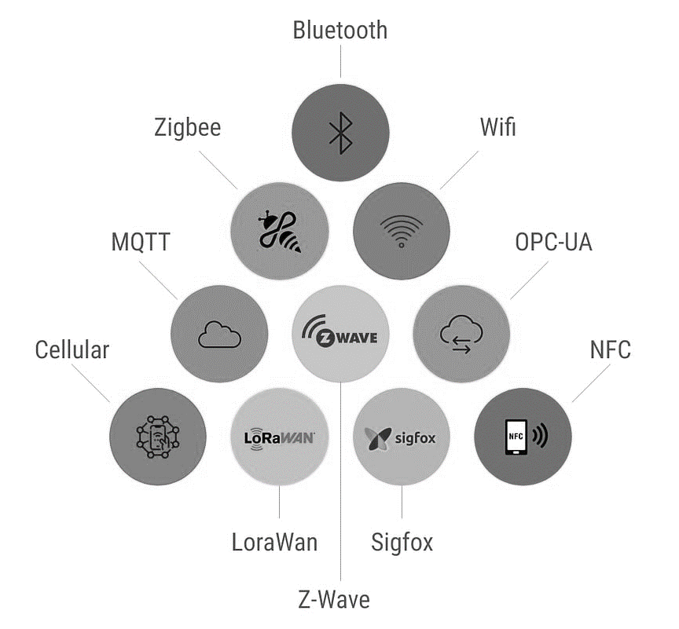
Enabling Technologies - Communication Protocols
Protocols are the pillars for good IoT infrastructure and hence are very important in communication.
Data exchange happens through these protocols, which take care of the following:
Addressing.
Format of the messages.
Message security (encryption and decryption).
Routing.
Flow control.
Error monitoring.
Sequencing.
Retransmission guidelines.
Segmentation of the data packets.

Slide 34
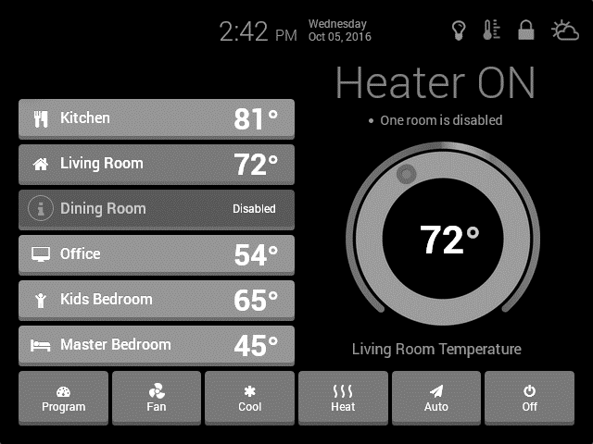
Enabling Technologies - User Interfaces
All devices should have an intuitive user interface.
IoT devices/services should be designed in such a way that accessing and handling the services are easier and comfortable for the end user.
Generally , the end user shall be provided “mobile application or web application”.
The application should be stable and elegant.

Slide 35
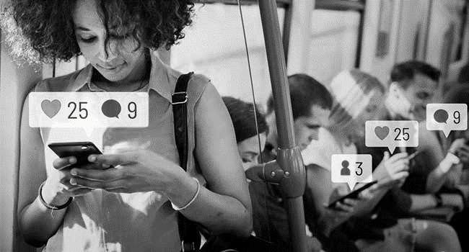
IoT Challenges
The following are some of the challenges - technical and non-technical during building an IoT application .
Security/Personnel safety:
Security is one of the most significant challenges.
Number of IoT devices are gradually increasing, so user data becomes more vulnerable to theft.
Poor security features can let attackers damage the whole network and the rest of the devices could also become vulnerable.
People’s personal safety is also a concern and challenge.
The implants and wearable used by people should be safe even from physical harm.

Slide 36
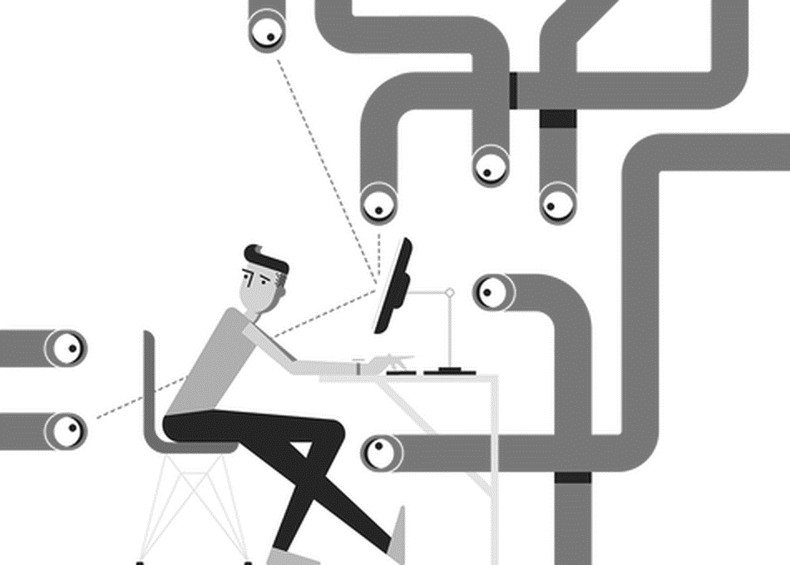
IoT Challenges
Privacy:
One could be tracked/monitored by anyone, as we are connected 24 × 7 to the Internet.
So, there is a threat on user data and raises a question on user privacy.
“How do we ensure that the data that is sensed and collected from the user is with their permission?”

Slide 37
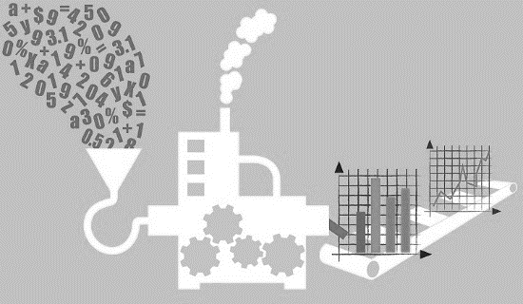
IoT Challenges
Data extraction with consistency from complex environments:
It is a huge challenge to sense and extract data from complex environments.
For Example, variation in temperature could also damage the products being transported.
Maintained the temperature is very critical and should be accurately monitored.
If the temperature is about to change, then the corrective action has to be taken.
Data extraction and storage in the cloud could be more challenging if the internet is not available.
Extracting data inside a room is different from extracting data from an open environment.

Slide 38
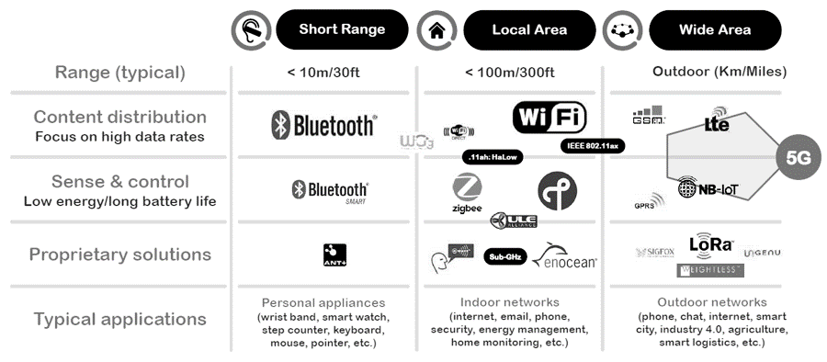
IoT Challenges
Connectivity:
This is a serious challenge that the IoT world must acknowledge.
Since the Internet is itself a giant collection of networks and devices and IoT is a part of it. So requirement of wired and wireless connectivity is a necessity.
The usage of frequency / spectrum is also to be noted.
There are spectrum regulations to be followed based on the country for which the application is being developed.
2.4 GHz band is the ideal band everywhere.

Slide 39
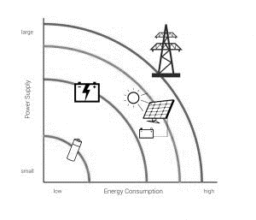
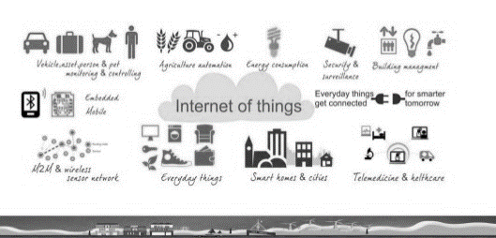
IoT Challenges
Power requirements:
All the IoT devices require power and most of them are battery operated.
Even though we now have long-lasting batteries that are economical, demand for power is on the rise.
Usage of green power sources such as solar and wind should be motivated.
If the power requirements are met appropriately, IoT can be even more powerful.
Complexity involved:
IoT is not easy. It needs a lot of different domains to integrate into a cohesive system.
There is very limited expertise available in the market, but the growth is very rapid.
The toolkits, software and hardware are not abundant and real skill is required to build an application.

Slide 40
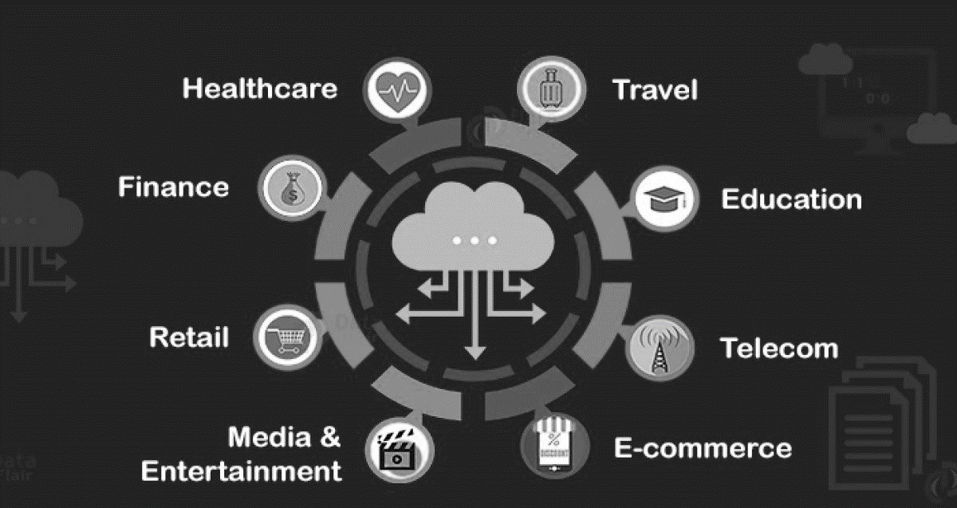
IoT Challenges
Storage:
Cloud is becoming mandatory for the data to be stored and analyzed.
The challenge with respect to this aspect is connected to the following points:
Which cloud do we use (private, public, or hybrid)?
How do we identify the service provider?
How much does it cost?
Do we really need cloud?

Slide 41
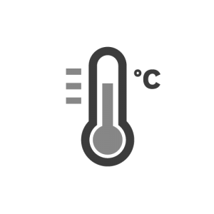
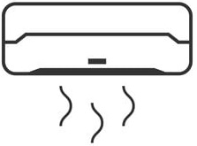

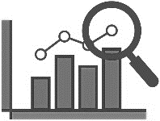

IoT Levels
Based on the architectural approach, IoT can be classified in five levels: Level 1 to Level 5.
Level 1
It is of minimal complexity.
The application has one sensor (temperature sensor, pressure sensor, etc).
The data sensed is stored locally and the data analysis is done locally.
Monitoring / control is done through an application.
This is used for simple applications.
Data generated in this level application is not huge.
For example, a temperature sensor senses the room temperature and the data is stored and analyzed locally.
Based on the analysis, the control action can be triggered through mobile application or it can help in monitoring the status.
Air Conditioner
Temperature Sensor
Data Collection
and
Analysis
Done Locally
Controlling
and
Monitoring Action

Slide 42
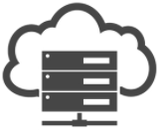
IoT Levels
Level 2
The second level is slightly more complex than the previous level.
The data is more voluminous and hence, cloud storage is preferred.
The frequency of sensing done by the sensor is faster.
The number of times sensing is done would be much more than Level 1.
The analysis is carried out locally, while cloud is meant for storage only.
Based on the data analysis, the control action can be triggered through the web application or mobile application.
Some examples are agriculture applications, room freshening solutions based on odor, etc.
IoT application of an air conditioner. The sensor reads the room temperature at a better pace and rate than Level 1; the data then goes on to the cloud for storage. Analysis is done locally and the action is triggered through the mobile application.
Air Conditioner
Temperature Sensor
Data Analysis Done Locally
Cloud
Data Stored Here
(Bigger than Level 1)
Controlling
and
Monitoring Action

Slide 43

IoT Levels
Level 3
The data is huge, frequency of sensing done by the sensor is faster and the data is stored on cloud.
The difference is that the analysis is also carried out on cloud.
Based on the data analysis, the control action can be triggered through the web application or mobile application.
Some examples are agriculture applications, room freshening solutions based on odor, etc., where analysis of data occurs in the cloud.
Air Conditioner
Cloud
Data Stored and
Analysis
Both Done Here
Controlling
and
Monitoring Action
Temperature Sensor

Slide 44



IoT Levels
Level 4
With every passing level, the volume of data increases and hence the rate at which it is sensed also increases.
At this level, multiple nodes are present which are independent of each other.
These nodes upload data to the cloud.
All the sensors upload the read sensory inputs on cloud storage.
Analysis is also carried out on the cloud.
Based on the analysis carried out, the control action shall be triggered through a web application or mobile application.
Cloud
Data Collection and
Analysis Done Here
Temperature Sensor
Moisture Sensor
Controlling
and
Monitoring Action
PH Sensor

Slide 45
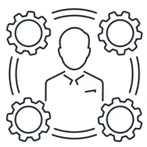
IoT Levels
Level 5
At this level, the amount of data is extensive and is sensed much faster.
Multiple nodes are involved in the applications categorized under Level 5 and these nodes are independent of each other.
The sensing of data and its storage is the same as in all the previous levels.
When an application is completely cloud oriented, it is computationally intensive in real time.
Based on the data analysis, the control action can be triggered through web application or mobile application as in all other levels.
Cloud Data Collection and
Analysis Done Here
Temperature Sensor
Moisture Sensor
Coordinator Node
Controlling
and
Monitoring Action
PH Sensor

Slide 46
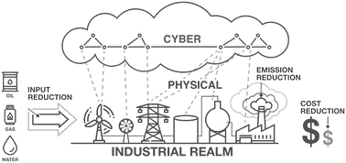
Cyber Physical System versus IoT
An important question is, Is IoT same as Cyber Physical System (CPS)?
There is a misconception that both the terms are the same.
We have learned the definition of IoT. The “thing” can also be accessed from anywhere, anytime by an authorized party.
The information or the sensed data of the things can be simple.
So complexity involved in the IoT applications is minimal.
For complex levels of operation and to address larger network of “things”, a new term called Cyber Physical System or CPS, has been introduced.

Slide 47

Cyber Physical System versus IoT
It is important to note that CPS is not IoT.
CPS is more complex than IoT and is much more challenging.
CPS has IoT as one of its components.
It is a combination of multiple engineering domains coming together.
The flight of an aero plane can be seen as a CPS which involves multiple domains of engineering.
CPS is much more autonomous than IoT, taking appropriate decisions as and when needed.
It is not just about identifying “things”; it is more about understanding and taking decisions in a more dynamic way.
CPS is mainly concerned about the collaborative activity of sensors or actuators to achieve a certain goal.
For that CPS uses an IoT system to achieve the collaborative work of the distributed systems.

Slide 48

Wireless Sensor Network versus IoT
WSN is a network of multiple autonomous sensors/nodes.
Each node has one or more sensors.
All the sensed data are passed to a centrally located server.
The data passing happens in a coordinated pattern.
We can say that WSN is all about coordinated data collection.
On the other hand, IoT is much more than just data collection and the systems are more intelligent.

Slide 49
Summary
IoT refers to the interconnection of computing devices embedded in everyday objects via the Internet, enabling them to send and receive data.
IoT is not owned by any one engineering branch. It is a reality when multiple domains join forces and combine efforts.
IoT is all about providing service to any device, anywhere, anybody, and any network.
IoT has certain characteristics which are important: a. Connectivity. b. Intelligence and identity. c. Scalability. d. Dynamic and self-adapting (complexity). e. Architecture. f. Safety.
“Things” refer to variety of devices. At times, even humans in the loop becomes a thing. For anything to qualify as a “thing”, it requires identity. The “thing” can monitor, measure, etc.; for example, a temperature sensor could be a “thing”.
One should understand that “THINGS” = HARDWARE + SOFTWARE + DATA + SERVICE
IoT stack has seven layers, starting with sensor layer and ending with application layer just as OSI.

Slide 50
Summary
Security/personnel safety, privacy, data extraction with consistency from complex environments, connectivity, power requirements, complexity involved and storage are the major challenges we face while building an IoT application.
IoT application can be classified as Level 1, 2, 3, 4 or 5 based on the complexity and architecture involved.
IoT is all about sense, connect, store, analyze, control and sharing.

